Slide 1
INTERNSHIP STUDIO
PROJECT SUBMISSION-ETHICAL HACKING

Slide 2
Task1
Screenshot of solved portswigger labs
Task1:To solve any 5 labs in Portswigger Labs

Slide 3
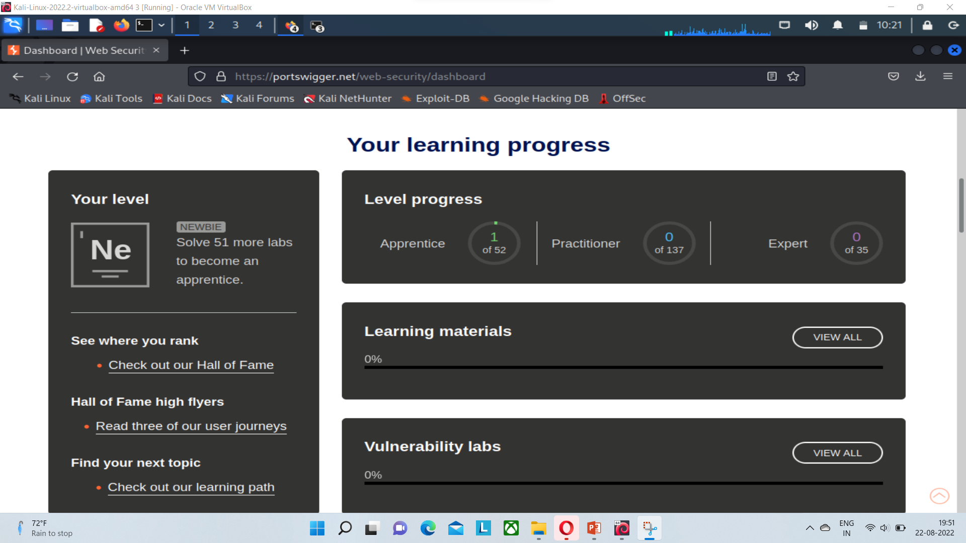
Screenshot1

Slide 4
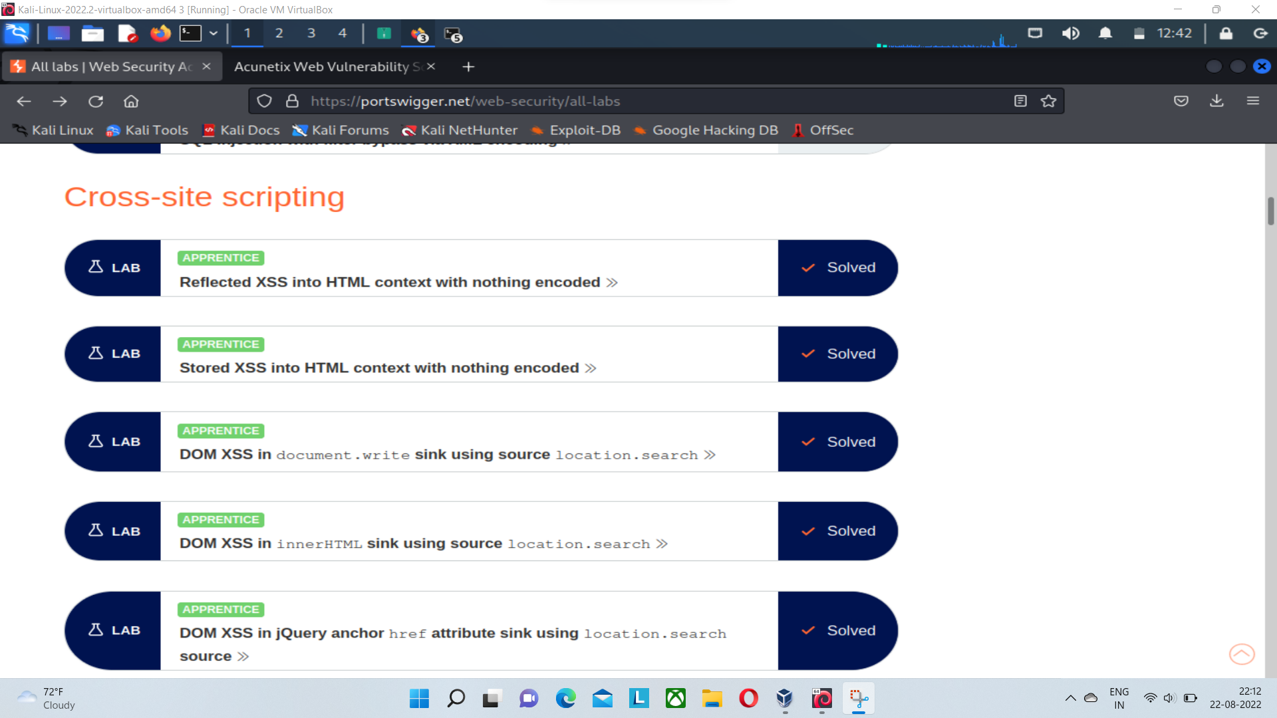
Screenshot2

Slide 5
Task2
Vulnerabilities found using QWASP
Task2:To find the vulnerabilities on the website
http://zero.webappsecurity.com/ and to prepare a report for the same

Slide 6
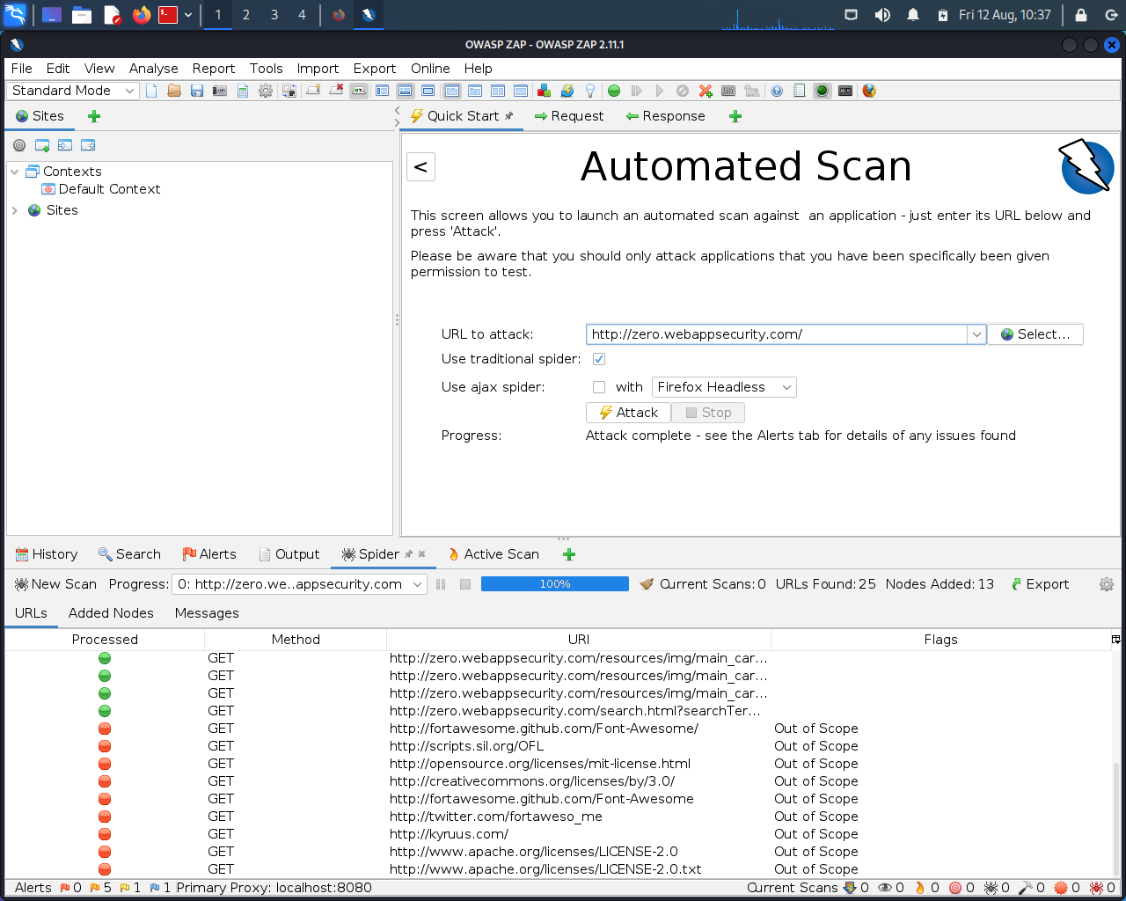
Screenshot1

Slide 7
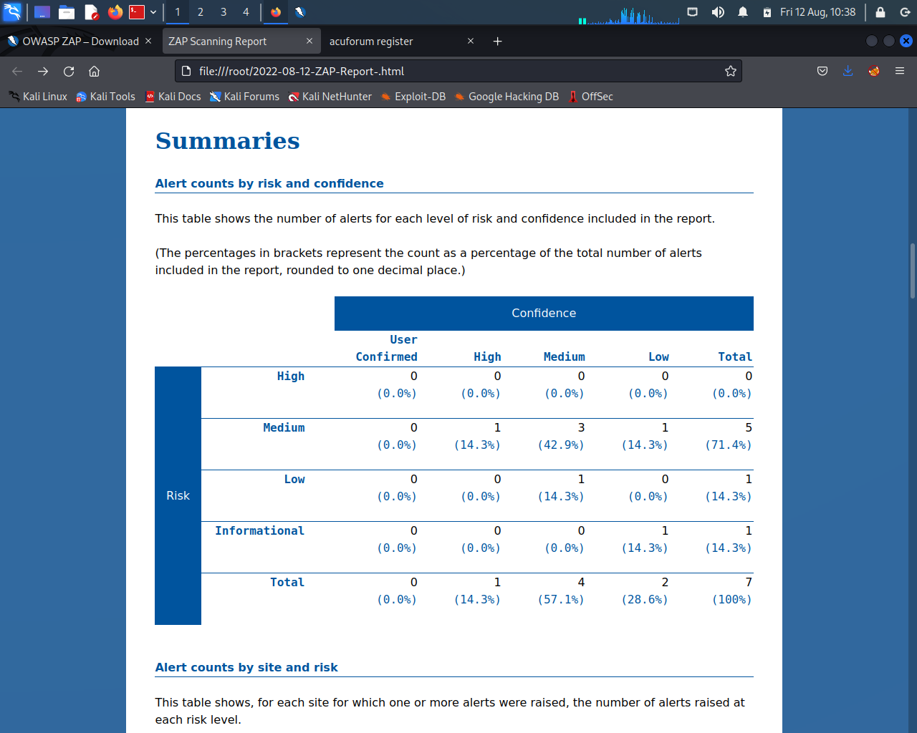
Screenshot2

Slide 8
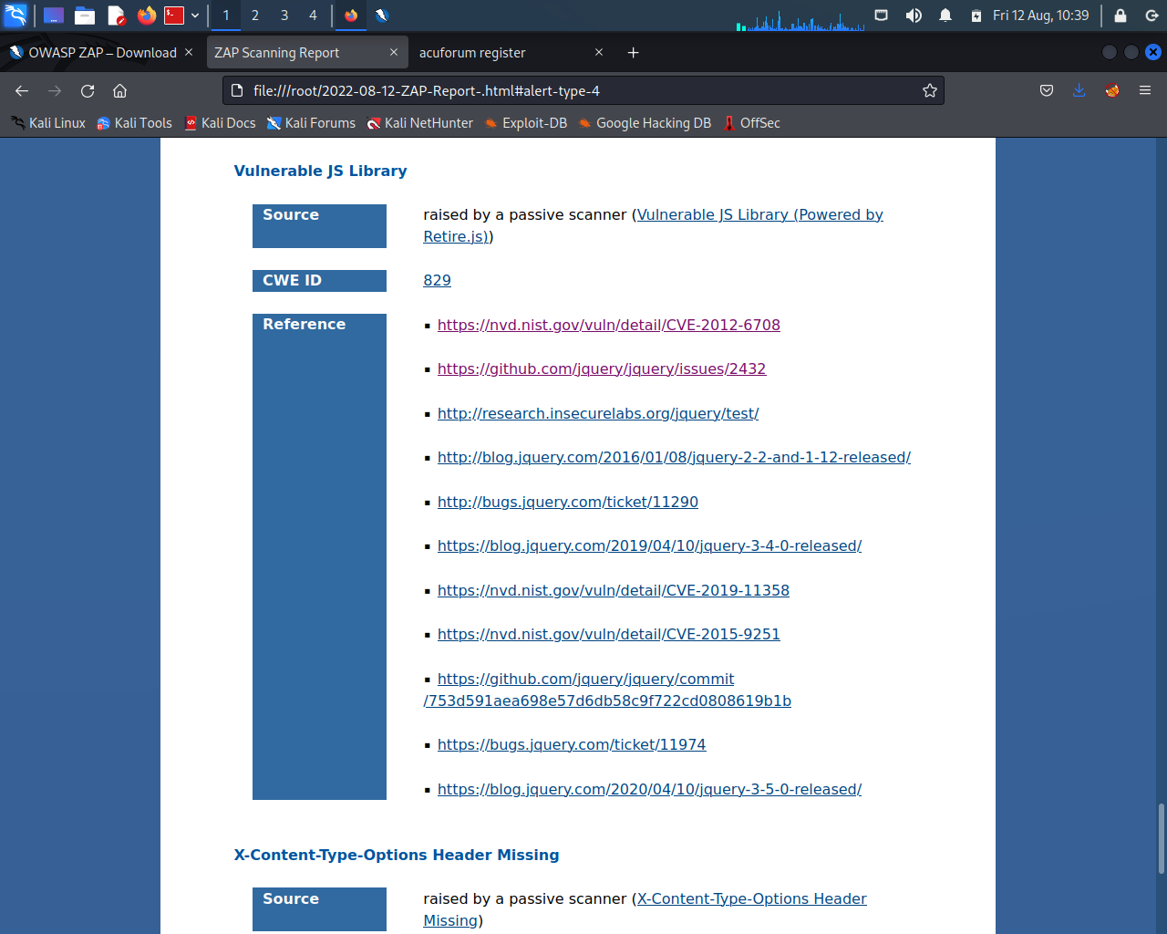
Screenshot3

Slide 9
Report
Title:Vulnerability in JS Library
Domain>>http://webappsecurity.com
Sub Domain>>http://zero.webappsecurity.com/resources/js/jquery1.8.2.min.js
Linux 7.1,OWASP ZAP,Wifi
Description:vulnerability in JS Library was found.the library jquery,version 1.8.2 is vulnerable
Solution: The vulnerability found on the library jquery can be resolved by installing the latest version of jquery,version 3.6.0
Reference:https://nvd.nst.gov/vuln/detail/CVE-2012-6708
https://github.com/jquery/jquery/issues/243

Slide 10
Task 3
Vulnerabilities in the website:
http://testasp.vulweb.com/

Slide 11
Report
Title-Cross Site Scripting
--
Domain>>http://vulweb.com/
Sub domain>>http://testasp.vulweb.com/login
--
Linux 7.1,Wifi
--
Description-Cross site Scripting we found in the web application.

Slide 12
Report(cont.)
Steps to Reproduce
Step1:Visit http://testasp.vulnweb.com/
Step2:On the top menu you will find a Register option
Step3:Now in the username section fill a XSS payloads
(<script>alert(1)</script>).
Step4:After successfully registering,click on Login.
Step5:After login through the payload as username,it will give the alert(1) applet prompt up

Slide 13
Report(cont.)
Impact: Any Black Hat Hacker can steel the private and confedential data of our users
It can led to the security alert of our users who have full faith on us.
Attachers can find the cookies of the user which can be harmful for our users
POC: For Proof of Concept,the supporting documents are attached in the report.
Task 3(1).png
Task 3(2).png
Task 3(3).png
Task 3.mp4

Slide 14
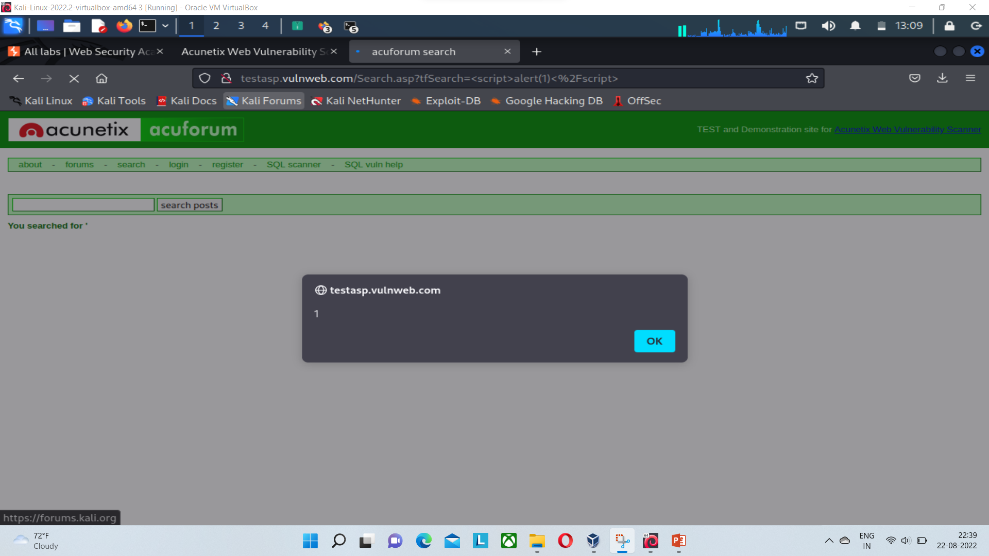
Screenshot1

Slide 15
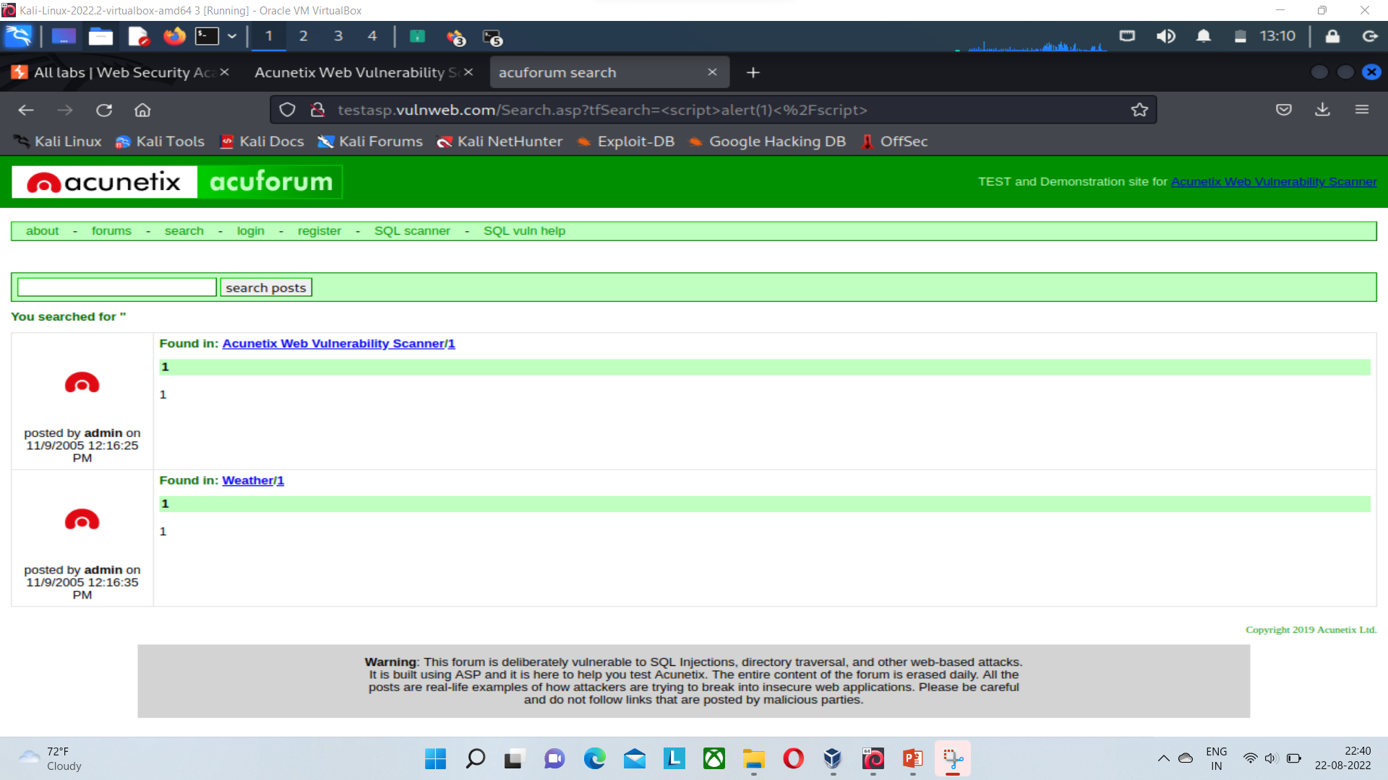
Screenshot2

Slide 16
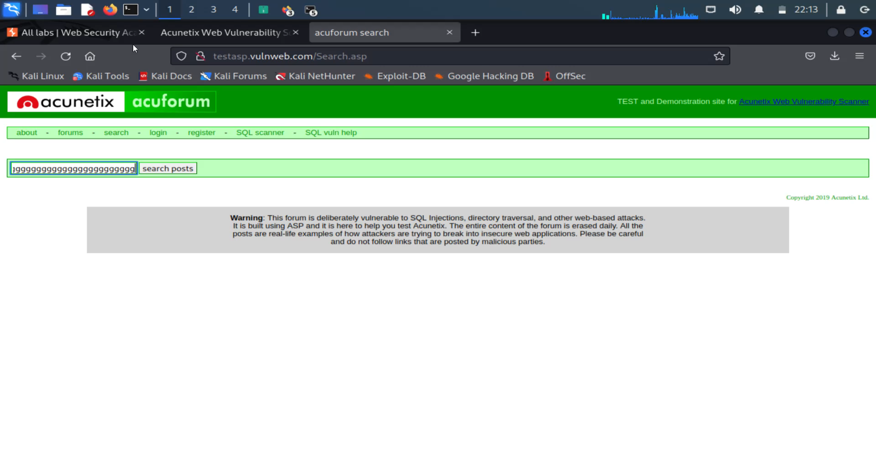
Video of the vulnerability

Slide 17
Thank you

